Slide 1
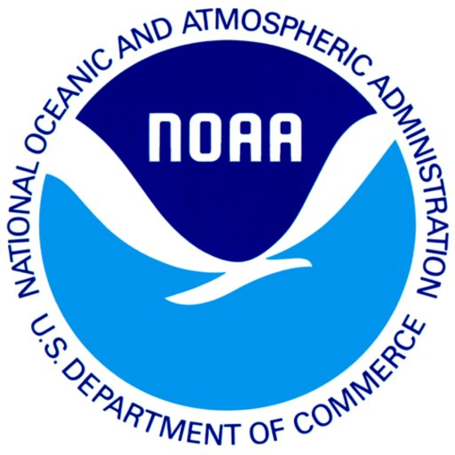
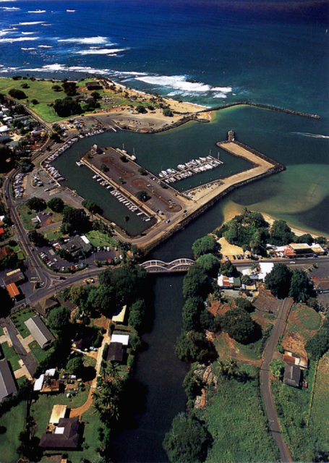
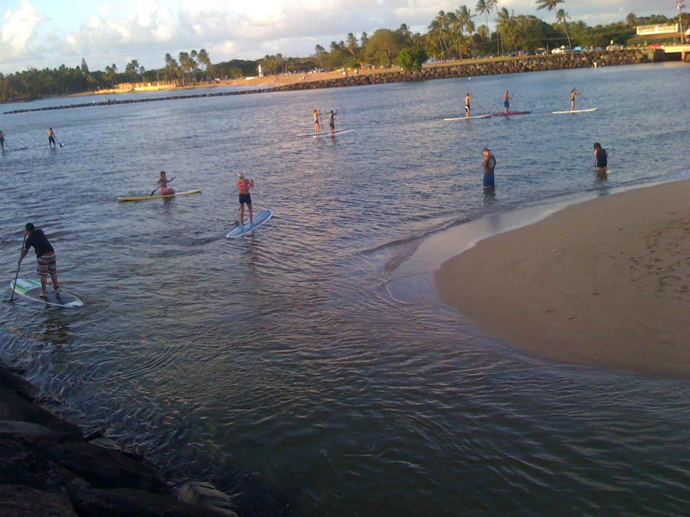
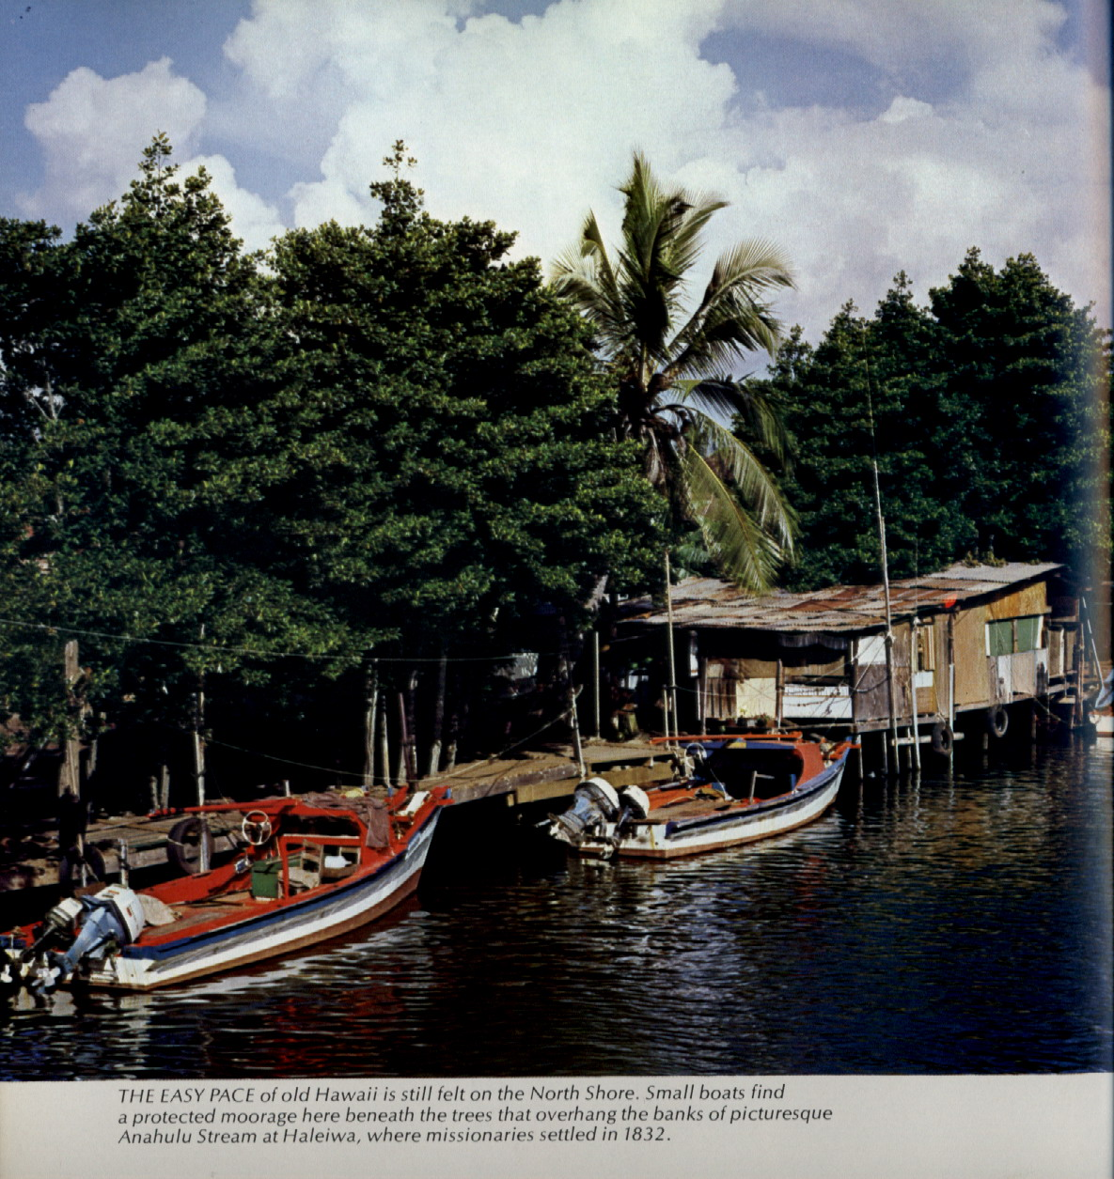
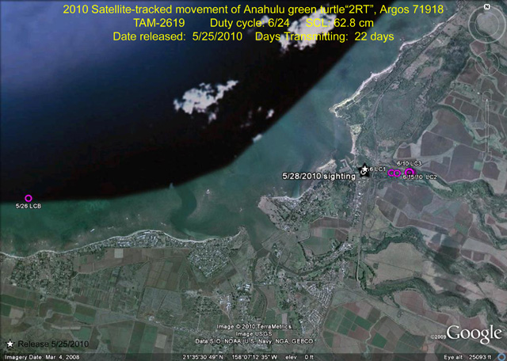
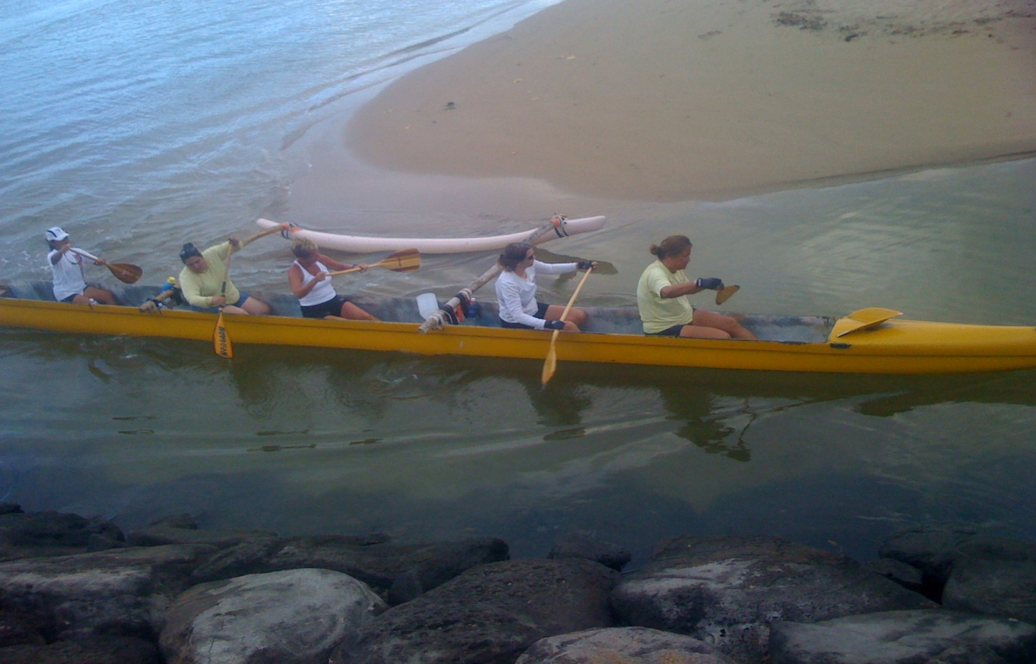
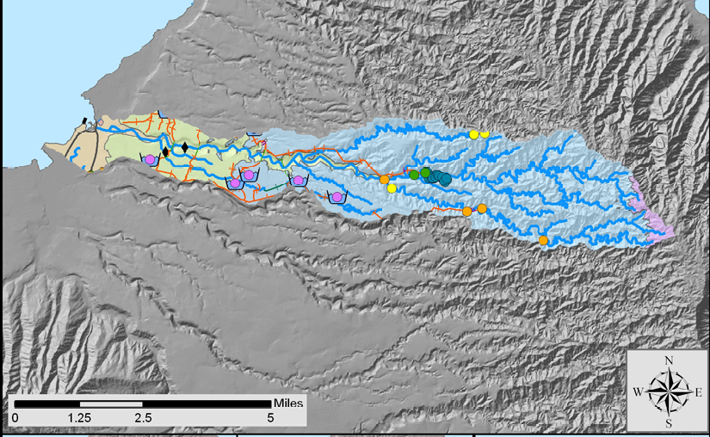
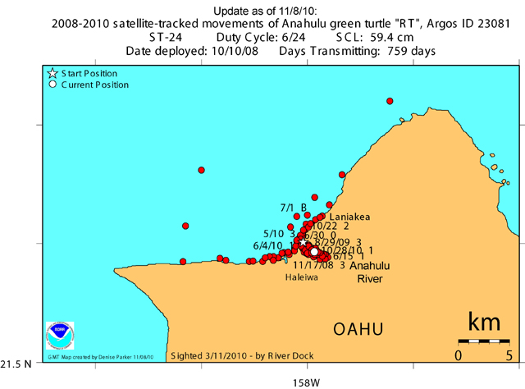
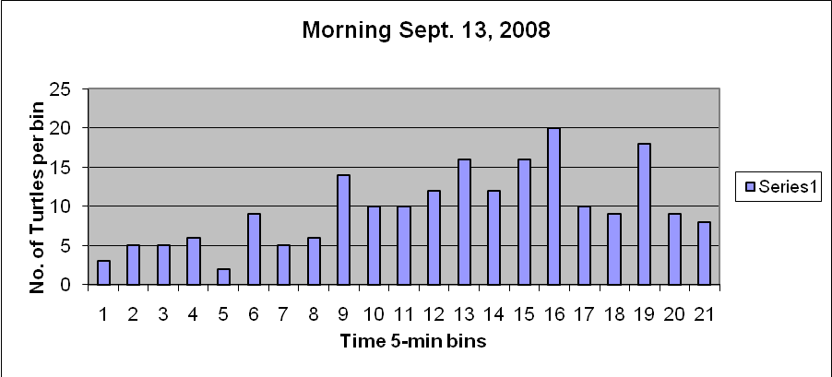
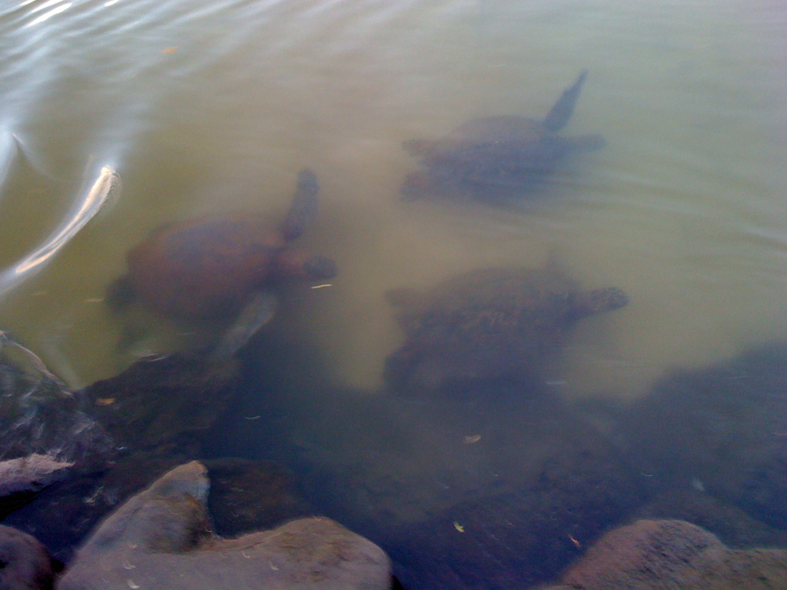
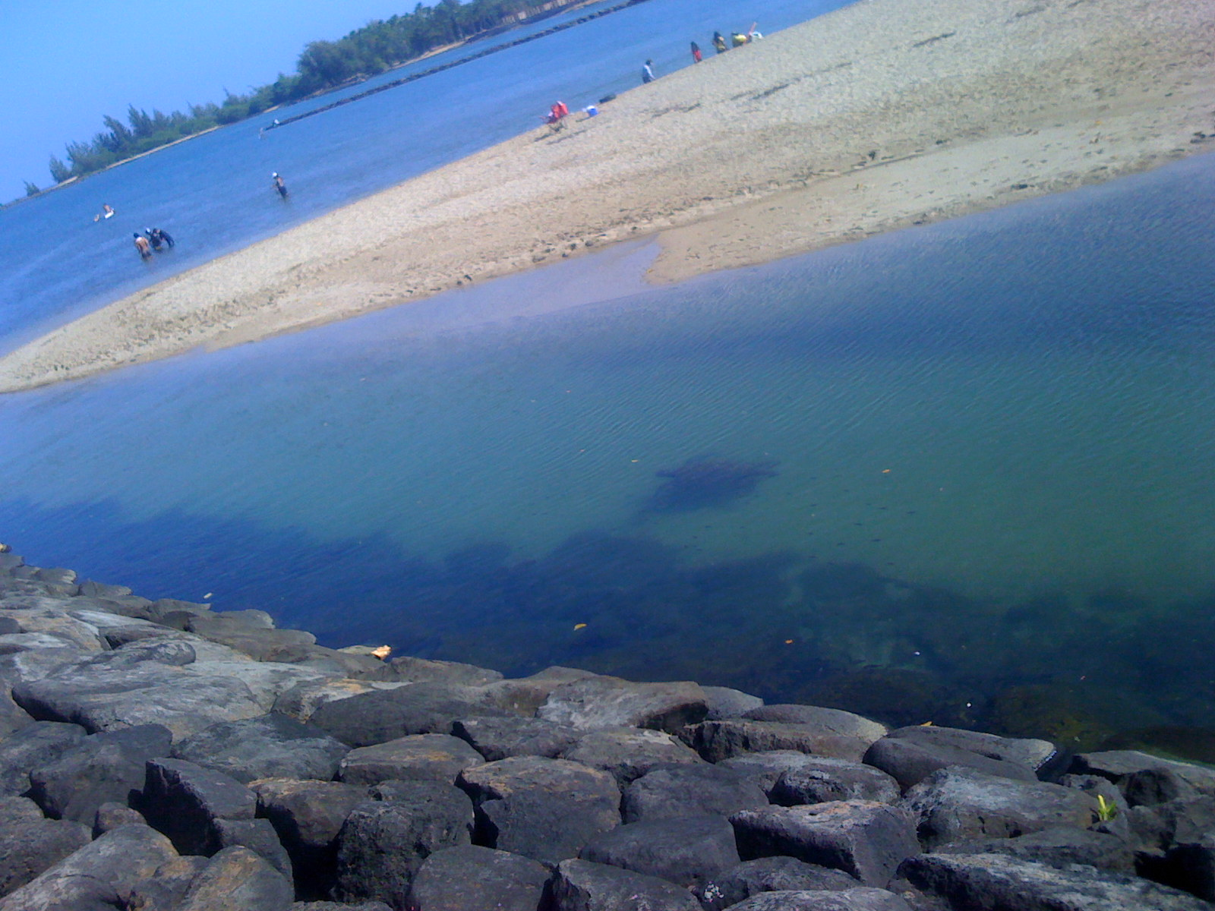
Green Sea Turtles Up and Down the Anahulu River
David L. Clarke¹, George Balazs², Stacy Hargrove²
Abstract
¹ Iolani High School, Honolulu Hawaii ² NMFS Pacific Islands Fisheries Science Center, 2570 Dole St, Honolulu, Hawaii
Satellite Tagging
Green turtles (Chelonia mydas) have become very numerous and popular in Hawaii. Tourists flock to see them on the North Shore of Oahu most notably at Laniakea Beach causing traffic congestion and safety concerns. Here we provide preliminary information on what may be some of the densest concentrations of green turtles in the Hawaiian Archipelago outside of seasonal nesting at French Frigate Shoals. Green turtle movements were monitored by visual counts at the Anahulu River mouth at Haleiwa for a total of 9 evening and 2 morning observation sessions during the months of September and October 2008- a period of almost no surf or rainfall on Oahu's North Shore. During 22 hours of observation 968 green turtle sightings were made moving either upstream or downstream (all counts may involves individuals being counted more than once). 122 (12.6%) were recorded as being juveniles <50 cm, and 87.4% as either sub-adults or adults. The greatest number seen (N=205) was during a morning observation session; most were moving downstream, while 31 were moving upstream. In other instances sightings were not as impressive with as few as 11 turtles observed during a 120 minute evening viewing session. Up to 20 individuals were recorded during a 5-minute period. On average during a 2-hour viewing session 88 individuals were recorded. All turtles appeared in good health, with only 1% being recorded with tumors and 2 with missing fins. One turtle was observed with fishing line and a plastic bobber attached to its fin, but it was moving freely. A total of 26 adult males were identified but no gender breakdown was determined during observations.
We satellite tagged two of the turtles and confirmed heavy use of the Anahulu River habitat, along with adjacent sea areas of Kaiaka, Waialua, and Haleiwa. The tracks clearly showed the turtles moving up and down the river, inland as far as approximately 3 km. A hypothesis for these movements may be related to the safety the river provides, as most predators like large tiger sharks apparently do not venture up the river, however other hypotheses appear plausable.
The Anahulu River mouth was observed to be an area of considerable water-based recreational activities including swimming, stand-up, canoe and kayak paddling and fishing. The human activities appeared to have little or no impact on the turtles' movements. Tides and water flow appeared to be greater issues for the turtles. At certain times of the year, and periods of the day, the Anahulu River mouth may be one of the best and safest areas in all of Hawaii to view turtles in their natural environment. This study documents what may be one of the most significant green turtle resting habitats in the Hawaiian Islands and further monitoring and investigation are highly recommended.
Observation area
The satellite tracking system used was Argos--,a French satellite system. A signal was sent from the tag, a Telonics model TAM-2619, to a satellite circling the earth (see; http://www.telonics.com/products/argosMarine/). Satellite tags were deployed on two green sea turtles. Tags were attached to turtles using resin and fiberglass. Tags were registered into a tracking system and position coordinates were obtained when turtles surfaced. Signals were sent to ARGOS satellites by the tags--and then onto a computer at a base station on Earth – in this case to a tracking station in Oregon that developed the graphics used here. The person mapped the coordinates electronically. The plots of the tracks show where the turtle went.
Figure 5. Constant human activity at river mouth during day light.
Movements – in the Ocean and into the River
The satellite tag shows the specimen moving up river at least 1.5 kilometers and then moving offshore spending time in Kai’aka and Waialua Bays. A preliminary analysis of the tag results suggest:
The turtle is highly focused or fixated on the immediate near shore areas of Haleiwa. No long distance movements have been documented. Coupled with what we know from visual observations of turtles using the Anahulu River area, the conclusion could be drawn, with some informed opinion, that RT exhibits behavior representative of most of many turtles known to use the area. That is, going into the river to rest, and foraging in the immediate region of Haleiwa. Another significant finding is the use of the Haleiwa Small Boat Harbor. The high accuracy of the Argos position confirms that at time the turtle (hence likely other turtles) enters into the harbor-- like a small boat seeking shelter. And last, some of the positions for RT are sufficient to say that at times use is made (for resting likely) of river areas well inland up beyond the bridge.
Figure 4.
Aerial view of Anahulu River mouth
There may be some interference in the Anahulu River mouth for the turtles, since there are many people that use the river for physical and recreational activities. There are a lot of people on stand up paddleboards that use that area to launch and they seems to like to use the calm waters of the river. Kayak and Hawaiian canoes will move in and out of the river. And there are always lots of fishers using the channel and the river mouth entrance. Although some turtles appear to get frightened, they will pause or hover in deeper water then return to continue upriver. We believe the turtles may linger in the bay and wait for a calm time in the river mouth. The turtles may get annoyed, since this has been their turf they seem to be persistent at moving in and out of the river. But other than being an annoyance, we believe it really doesn’t matter, since they come and go anyways.
Figure 6. Historic view on the Anahulu river.
Figure 7. Paddlers entering the river. They do not realize they are paddling right on top of several turtles into the river.
Figure 9. Tracking of Turtle RT
Observation Methods - Determining the species of a turtle while in the water can be relatively easy with some experience and clear water. Accurately determining turtles’ sizes and their sex proved more difficult. We recorded time of day and divided observation periods into 5 minute periods or bins – with turtles going either in or out recorded in each 5 minute bin. Each observation session was either evening or morning – when turtles were coming in or out of the stream. Turtle sightings were also divided into size classes --between small – or those under 45 cm and those above – and these were called medium or large. Medium were considered sub-adult and large adult – but no distinction was recorded. Adult male turtles have a tail larger than their flippers and if these were seen it was recorded also. Finally, turtles may have tumors on their flippers, mouth or head – if these were clearly seen – then those were recorded also. We typically collected data by sitting on a seawall overlooking the stream, and wearing polarized glasses to reduce any glare on the water. Most evening sessions began in full sunlight and ended when we could not see turtles because of darkness – though flashlights were used to help determine turtle size. In all instances – turtles were still coming up river in the dark when we left and down river when we arrived in the morning.
Figure 1. Anahulu River watershed flowing toward Haleiwa Bay
The Anahulu River (also called Anahulu Stream) is the longest watercourse on the island of O'ahu in Hawai'i. The Hawaiian meaning of the name is “ten days”. Anahulu Stream is formed on the western side of the northern part of the Koolau Range approximately 7 mi (12 km) northeast of Wahiawa. It flows west-northwest descending through Kawailoa Gulch, then empties into the eastern end of Waialua Bay at Hale'iwa. Archaeological evidence indicates that the valley of the river near its mouth was the site of ancient Native Hawaiian villages. The river valley was abandoned but was later repopulated in the early 19th century, partly as the result of a policy by King Kamehameha I to grow food to support his military expeditions.
Figure 10. Positions of green sea turtle “RT”-showing repeated use of the Anahulu River and North Shore coastal habitat.
RESULTS TO INFORM FUTURE STUDIES For morning sessions it appears that approximately 250 minutes are needed to get a completed sample (see Figure 8 of sampling results for the morning of Sept. 13 2008) and for the evening it appears at least that period of time should be used. For the morning sessions – it is recommended that sampling begins before first light and goes to 90 minutes after sunrise—though turtles have been seen going out over 3 hours after sunrise. Evening sessions should begin 2 hours before unset and go approximately one hour after. Our data suggest that the numbers provided here are an underestimate of the numbers of turtles using Anahulu Stream as resting habitat.
CONCLUSIONS The Anahulu River may provide some of the most significant green sea turtle habitat in the main Hawaiian Islands, although considerable future research will be needed to confirm this hypothesis. No matter what the outcome of future studies the mouth of the Anaulu River provides one of the best places on Oahu to view green sea turtles in their natural habitat.
Figure 8. Sampling of turtle numbers in 5 minute bins on the morning of September 13, 2008.
Figure 2.
River mouth is narrow, resulting in a high density of turtles at one time.
Figure 3.
View of river mouth with the water clarity at its best.
Acknowledgments
Mr. Rob O’Conner for printing my presentation, to Ms. Zoe Clarke (my sister) for helping recording data when I could not, and to Mr. Ray Clarke (my dad) for helping me complete this project.

